Slide 1

ADITYA CASE STUDY ASSESSMENT
(Group-2)
CASE STUDY ON SUPER MARKET ANALYSIS
Presented By:
1.Patrayani Srividya
2.Kaushik Adiraju
3.Niharika Ryali
4.Nakka Siva Manikanta
5.Ramesh Thanari
6.Sunkara Dorababu
7.Tutta subrahmanya swami
Under The Guidance Of
GAURAV SINGH
Senior Faculty Data Science

Slide 2

Business Objective, Understanding And Approach
Business Objective
Understanding
The main objective of the client is to boost their future sales and rule out its competitors by knowing where and why their sales are low in particular areas.
In expense of their past 2 years data they are in need of different strategies and predictions which will enable them to thrive in the market.
According to us the supermarket chain we are dealing with
has spread its wings all over the world in different countries.
We have a Market Sales data , the quality of the given data is
very Clear, which we do not have any duplicate values.
We have missing values only in one variable , the missing percentage is 0.01%.
We have given 28 different categories of data variables, we removed some of the variables for efficient analysing of the data.
Approach
We analysed the following from the given data :
We have more sales in the products of Wines and Meat.
Most of the sales are done in the sector of Store Purchases.
Compared to the Campaign which was done recently, the campaign which are done before gives more good performance from customers.
Why we have more sales in that particular products with respective to other?

Slide 3
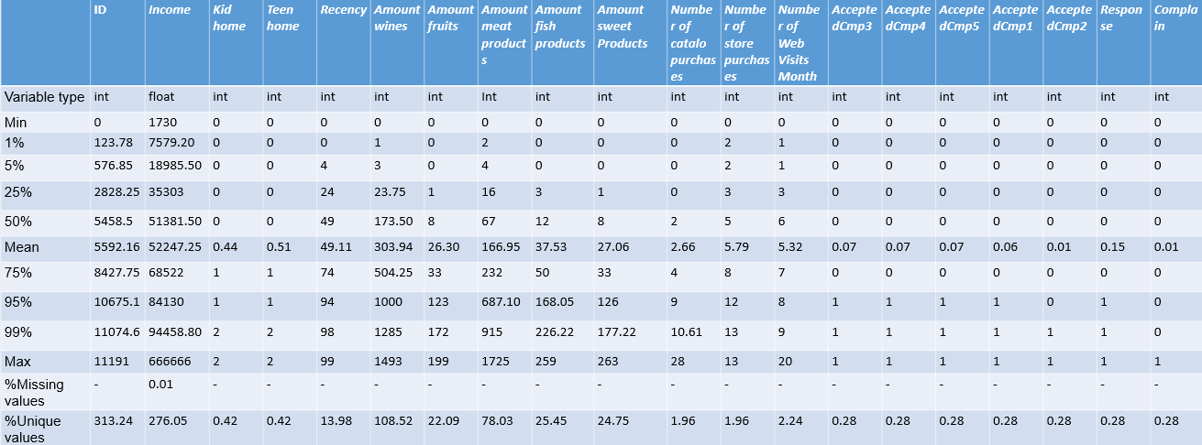
Extended Data Dictionary (EDD)
Findings from EDD :
Average Income of our given supermarket data is $ 52247.25.
The Percentage of our complain data is very less.
The Average sale of wine is very high when compared to other products.
The Average of store purchases is more when compared to other types of purchases.

Slide 4
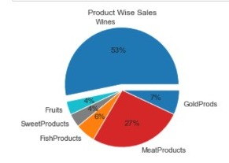
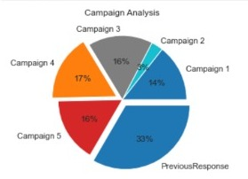
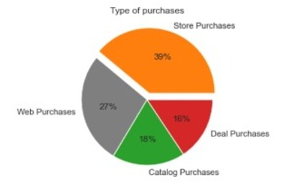
Analysing the different variables and understanding the key areas to be focused :
Key Insights :
Wines has the most number of products sales followed by meat.
Sweets and fruits have the least number of product sales.
Compared to all the campaigns held by the firm the latest campaign produced better results.
The customers mostly preferred store purchases than others.

Slide 5
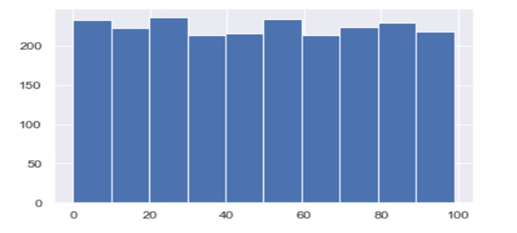
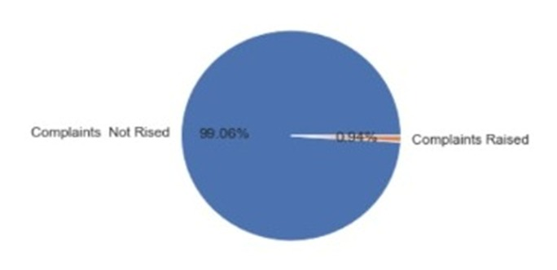
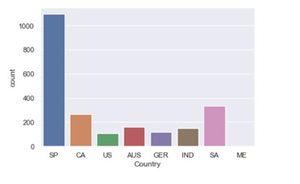
Analysing the different variables and understanding the key areas to be focused
Recency univariant analysis
Key Insights:
Recency variable says the recency of buying the products.From this graph, we can say the recency of buying the product is more for every 20days.
We can observe that the complaints raised by the customers is very low (0.94%).Hence we can assume that the quality of the product provided by the super market is excellent.
In the SPAIN we have highest number of sales when compared to MEXICO.

Slide 6
OUTLIER CORRECTION
Products | Fruits | Sweet | Wine | Meat | Fish | Gold
Maximum | 199 | 263 | 1494 | 1725 | 259 | 362
Corrected | 81 (Capped to 90th Percentile) | 82 (Capped to 90th Percentile) | 1200 (Capped to 96th Percentile) | 550 (Capped to 94th Percentile) | 130 (Capped to 90th Percentile) | 125 (Capped to 90th Percentile)

Slide 7
Feature Engineering – New Variables Created
SL. No | Variable Name | Variable Type | Description
1 | Total Spends | Numeric | Represents the total spending per customer
2 | Deals Purchases | Object | Given a particular keyword like 'low', 'high’, 'medium' based on number of values.
3 | Store Purchases | Object | Given a particular keyword like 'low', 'high’, 'medium' based on number of values.
4 | Catalogue Purchases | Object | Given a particular keyword like 'low', 'high’, 'medium' based on number of values.
5 | Web Purchases | Object | Given a particular keyword like 'low', 'high’, 'medium' based on number of values.
6 | Income | Float | Converted into float from object by removing $ sign

Slide 8
Key takeaways from initial analysis :
14% of the total customers have accepted campaign 1.
3% of the total customers have accepted campaign 2.
The percentage of total customers who have accepted both campaign 1 and 2 are very low.(only 13 of the total customers are in this niche)
The average number of Web conversions is found out to be 3 per web visit.
Half of the customers have a Web conversion rate of 4 per Web visits.
The customers who have visited the website less than 10 times in this 2 years has an average total spend of 609 and 50% of the customers has a 400 total spend average.
On the same lines the customers who have visited the website greater than 10 times in this year has an average total spend of 120 and 50% of the customers has a 52 total spend average.
Similarly the customers who have made the purchases on the basis of discount more than 10 times in this span has a total spending average of 899 and 50% of these customers has spending of 770.
The customers who have made in store purchases less than 10 times in this span have an average total spending of 480 and 50% of them has a spending of 218.
The customers who have made in store purchases greater than 10 times in this span an average total spending of 1120 and 50% of them has a spending of 1069.
Customers who have the most total spending average hail from 'Mexico' and 50 percent of them has a total spending of 990
Customers who have the most total spending average are 'Absurd' and 50 percent of them has a total spending of 1027.5
Customers who have the most total spending average are having a 'Masters' degree and their median total spending is 387.5

Slide 9
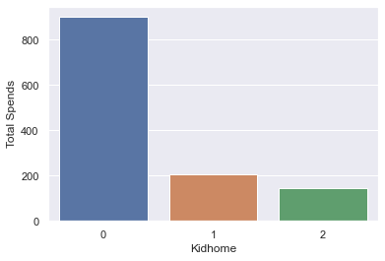
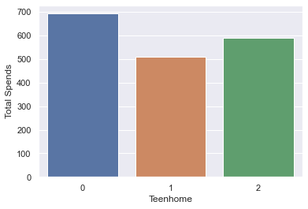
Key insights :
The customers who are not having kids and teens at home tend to spend more on different types of products.
Customers who are more inclined to do more number of store purchases tend to spend more on products.
Customers who are having their income in the range of 60,000 to 80,000 tend to spend most.
Customers who have accepted the campaign 5 spent most.

Slide 10
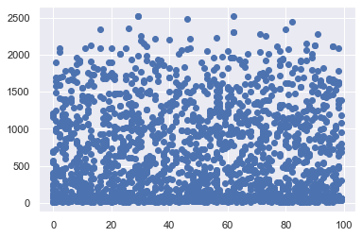
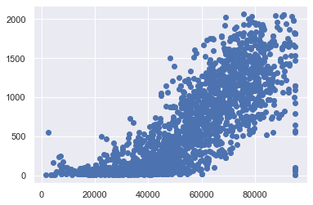
Key take aways from particular value analysis :
Customers who spent more on different products types are:
Education - Graduation .
Marital Status – Married.
Income Range - 60,000 to 80,000.
Campaign - Campaign4 accepted people.
Country – Spain.

Slide 11
Particular Observations for Web Visits
Variable | Web Visits
Total | 11909
Marital | Married
Education | Graduation
Kid home | ‘No’
Teen home | ‘No’
Previous Response | Maximum ‘No’
Campaigns | Mostly ‘No’
Country | Spain

Slide 12
Particular Observations for Wine and Meat products
Variable | Wines | Meat
Income | 60,000 – 80,000 | 60,000 – 80,000
Marital | Absurd | Absurd
Web Purchases | High | Medium
Store Purchases | High | High
Deal Purchases | High | Low
Previous Campaign | Yes | Yes
Campaigns | Campaign 2 | Campaign 5

Slide 13
Particular Observations for Web Purchases and Store purchases
Analysis/ Modeling Methodology
Variable | Web Purchases | Store Purchases
Spending | High | High
Education | Graduate | Graduate
Marital | High – Yolo Low - Absurd | High – Absurd Low – Alone
Income | High - 60,000 Low – 40,000 to 50,000 | High – 70,000 to 80,000 Low – 30,000 to 40,000
Campaign | All are same | All are same
Country | Spain | Spain
Data Preparation & EDA
Variable Creation and Selection
Model Development
Model Performance Testing
Sub-setting (keeping relevant variables/records, e.g. time duration
…
Extensive bi-variate analysis conducted on all meaningful variables
…
20+ new variables created as a part of feature engineering
Use one-hot encoding to create dummy variables
…
Random Forest chosen as the preferred modeling technique since…
…
Developed 10+ candidate models
Highest Model accuracy observed of 78%
Conducted k-cross validation for k=7
Model performance also assessed on a hold-out sample of size 30% of the original dataset
…

Slide 14
Recommendations :
By analysing the data we have observed that the quality of the product is good so the complaint rate is less ,we suggest the supermarket to maintain the same quality of the product .
Coming to the country wise sales the SPAIN is having highest sales and MEXICO is having low sales , so we suggest the supermarket to focus more in Mexican region to increase its sales by attracting the customers conducting campaigns or by giving discount offers .
The customers are likely to purchase the meat products and wine , by analysing we got to know that the discount has been given more in this two products .
So , we suggest them to focus on the remaining products and to ensure some discount on remaining with out having loss to their marginal price . Most purchases are done by the customers who are having their income below $ 80000.
The campaigning doesn’t have that much effect on the sales so we suggest them to change the way of campaigning to attract more customers.
The customers with annual income $40000 have more recency for every 20 days .
The company should focus on customers who are having their income in range 30,000-40,000 and the company should try to bring the product more affordable to these people not affecting their margins.
The company is advised to focus more on their fruit product in the U.S market
The company is suggested to focus more on its sweets,gold,fish products in the Mexican market and strengthen their base in Mexico.
The company should try to increase its stores in India and Australia for better customer reach.
The company should increase its catalog purchase experience in Australia and India.
The company should give discounts on wine products not effecting their margin.
The company should increase its product reach more to 'Married' People.

Slide 15


